Slide 1
FinEx.
Ignite
Possibilities

Slide 2
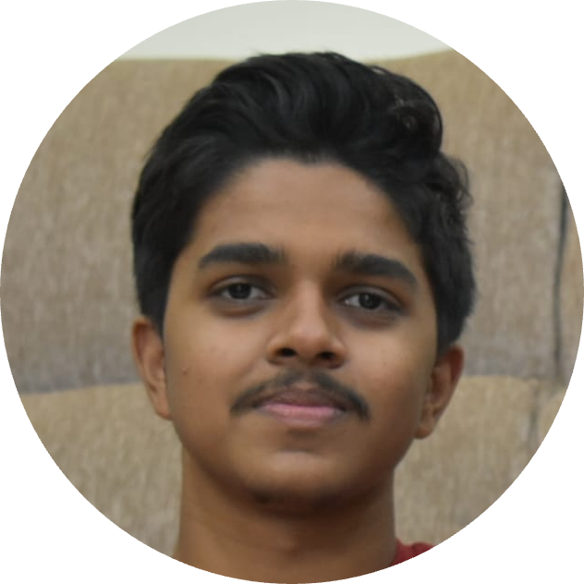
BCSE102L
Structured and Object Oriented Programming
Presented By
DINESH KUMAR M
22BRS1369
FinEx.
Ignite
Possibilities
Mentored By
Prof. Kaviya Elakkiya
AP/SCOPE
“Beware of little expenses; a small leak will sink a great ship.”

Slide 3
Infrastructure
Natural resources
Factors affecting Economic development
Education
Technology
Political stability
Trade policies

Slide 4
P E R C E N T A G E S
People’s income affected due to the economic downfall
50 PERCENT
35 PERCENT
15 PERCENT
LOW INCOME INDIVIDUALS
MIDDLE CLASS INDIVIDUALS
HIGH NET WORTH INDIVIDUALS
Peoples experienced a significant decline of approximately 50% of their income.
Peoples experienced a decline of approximately 35% of their income.
Peoples experienced a decline of approximately 15% of their income.

Slide 5
ANALYSIS
NET WORTH = Assets - Liabilities
Real Estates
Mortgages
Automobiles
Student loans
Saving accounts
ASSETS
LIABILITIES
Other Dept
Other Assets
Consumer
depts
Checking accounts
Personal
loans
Retirement savings
Auto loans

Slide 7
Challenge awaiting resolution
Problem:
Improving the financial status of families affected due to economic downfall
What is the purpose behind this action?
What approach are we taking to accomplish it?
Who stands to gain the resolution of this problem?

Slide 8
Our proposed solution to address the challenge:
01. Design/Development
02. Backend/Data management
Introducing an innovative mobile application designed to enhance the financial well-being of struggling families. This app provide a comprehensive suite of tools and resources, including budgeting, expense tracking, goal setting, and educational content on personal finance. By enabling users to make informed financial decisions, increase savings, and achieve long-term stability, the app empowers families to improve their financial status and build a brighter future.
Plan and design the User interface.
Set up a secure backend infrastructure.
03. Financial Tool/Resources
04. Testing/Development
Develop robust budgeting and expense tracking functionalities.
Conduct thorough testing to ensure the app functions correctly

Slide 9
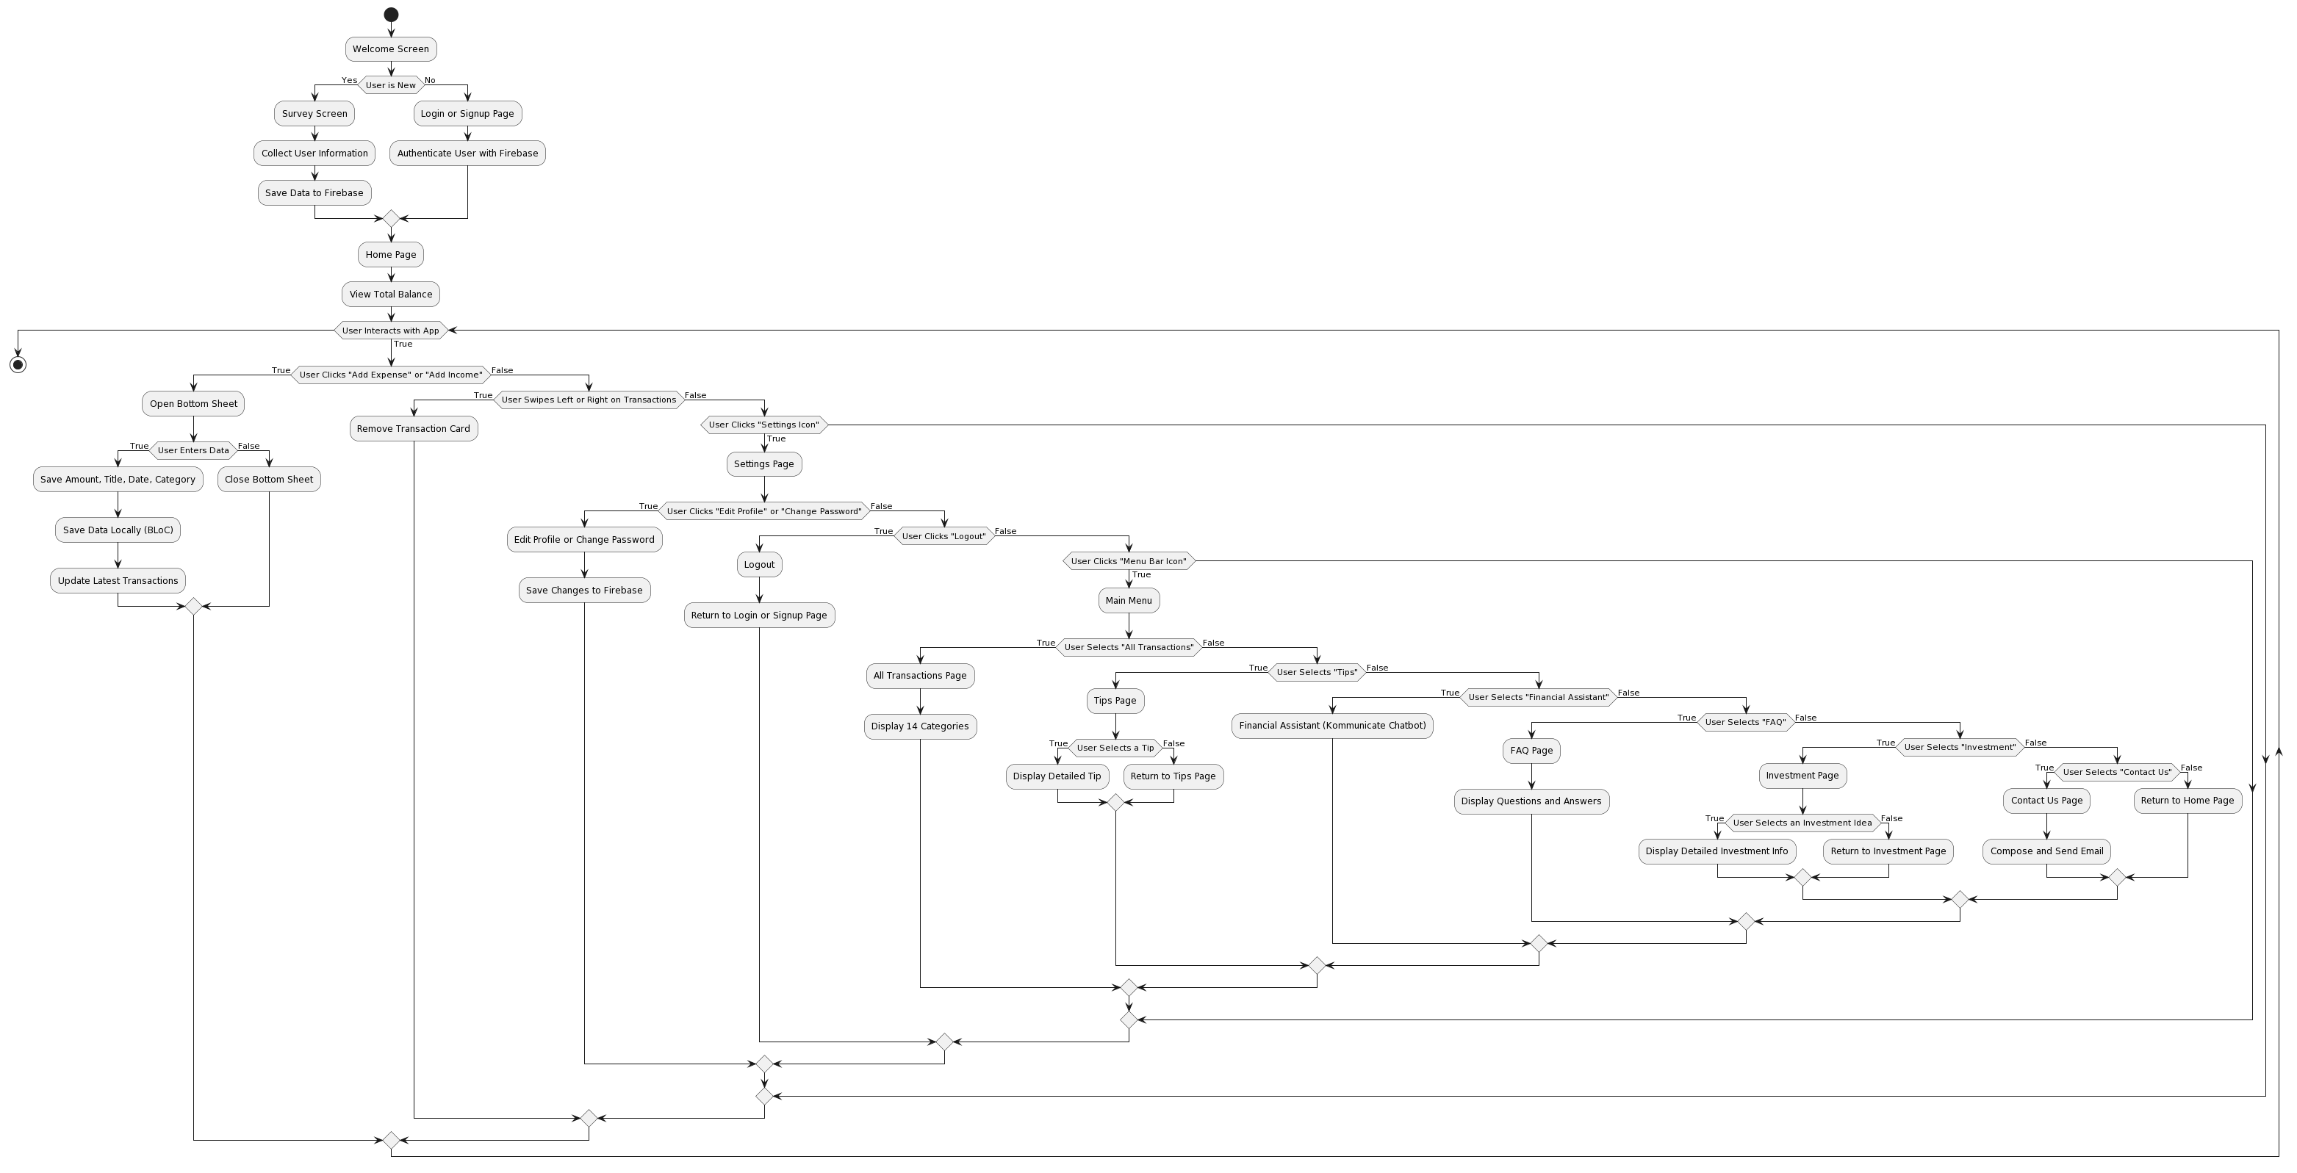
Architecture Diagram

Slide 10
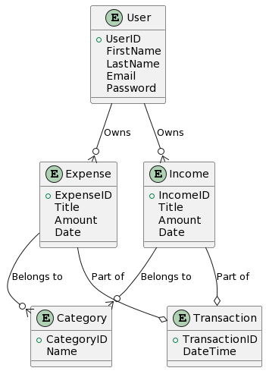
ER Diagram

Slide 11
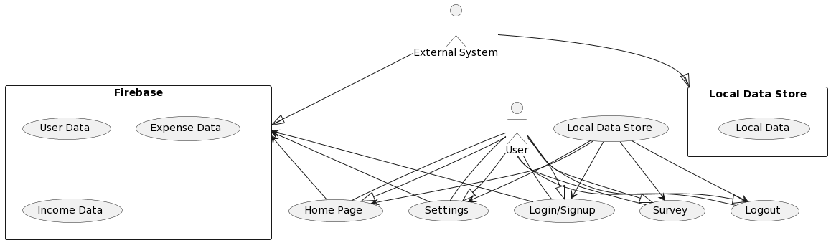
DFD Diagram

Slide 12
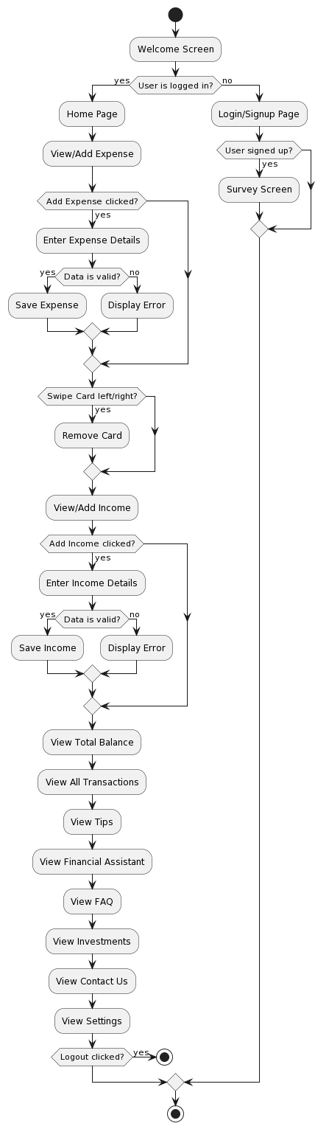
Activity Diagram

Slide 13






OOPS CONCEPTS USED
Encapsulation
Polymorphism
Encapsulation is used to bundle the data (attributes) and methods (functions) that operate on the data into cohesive units known as classes. For instance, the "Expense" and "Income" classes encapsulate the relevant data and functions.
Polymorphism allows different classes to be treated as instances of the same class through a common interface. In the app, this is evident when processing various transaction types (expenses and incomes) in a consistent manner, enhancing code flexibility.
POINT
01
POINT
04
Inheritance
Modularity
Inheritance is utilized to create a hierarchy of classes. For example, the "Expense" and "Income" classes inherit common attributes and methods from a base class, reducing redundancy and promoting code reusability.
OOP facilitates modularity, enabling the project to be divided into smaller, manageable modules or classes. For instance, the app segregates functionality into distinct modules, such as transaction management, financial advice, and FAQs, making it easier to develop and maintain.
POINT
02
POINT
05
Abstraction
Data Abstraction
Abstraction is employed to hide complex implementation details and provide a simplified interface. User interactions with the system are abstracted through user-friendly interfaces like the survey, dashboard, and chatbot, shielding users from the underlying complexity.
Data abstraction is achieved through the creation of user-defined data types like "Expense" and "Income." This allows for the representation of real-world financial data within the system, enhancing data integrity and reliability.
POINT
03
POINT
06

Slide 14
SUMMARY OF REVIEW-2
Introduction
Financial Overview
The project is a comprehensive financial management application that provides users with a powerful tool to efficiently manage their finances.
At the top of the dashboard, users can instantly view their total balance. This provides a quick snapshot of their financial health. The app categorizes transactions into 14 predefined categories, allowing users to analyze their spending habits.
POINT
01
POINT
04
Survey and Personalization
Features and Resources
Upon signup, users are guided through a survey to understand their financial goals and preferences. This information helps tailor the financial management experience, providing personalized insights and recommendations.
A built-in financial assistant powered by Kommunicate offers real-time guidance and answers to user queries. A comprehensive FAQ section addresses common financial queries, while an investment section offers ideas and detailed information for users to explore.
POINT
02
POINT
05
Dashboard and Transaction Management:
Settings and Contact
Clicking the "Add Expense" or "Add Income" button opens a user-friendly bottom sheet where users input details such as amount, title, date, and category.
Users can personalize their experience by adding a profile picture, editing their name, changing their password, and logging out. Additionally, the app provides a "Contact Us" feature, allowing users to send inquiries or feedback via email.
POINT
03
POINT
06

Slide 15
Array of technological tools
we intend to leverage
Visual Studio
Firebase
Figma
Creating an application that offers comprehensive expense tracking capabilities.
Acquiring data from the website and persistently storing the information to enable seamless integration with the created app.
Designing and animating the app with a user-centric approach to ensure a user-friendly experience.
React
Statista
Facilitating users with a secure platform for submitting their queries pertaining to financial management.
Gathering data for market analysis, market studies, and market research purposes.

Slide 16
Reference Papers
Ahmed, Syed Ishtiaque, Nicola J. Bidwell, Himanshu Zade, Srihari H. Muralidhar, Anupama Dhareshwar, Baneen Karachiwala, Cedrick N. Tandong, and Jacki O'Neill. "Peer-to-peer in the Workplace: A View from the Road." In Proceedings of the 2016 CHI Conference on Human Factors in Computing Systems, pp. 5063--5075. ACM, 2016. Google ScholarDigital Library
Bhamidipaty, Anuradha, and P. Deepak. "SymAB: symbol-based address book for the semi-literate mobile user." In IFIP Conference on Human-Computer Interaction, pp. 389--392. Springer, Berlin, Heidelberg, 2007. Google ScholarDigital Library
Cuendet, Sebastien, Indrani Medhi, Kalika Bali, and Edward Cutrell. "VideoKheti: making video content accessible to low-literate and novice users." In Proceedings of the SIGCHI Conference on Human Factors in Computing Systems, pp. 2833--2842. ACM, 2013. Google ScholarDigital Library
Cutrell, Edward, et al. "Blended learning in Indian colleges with massively empowered classroom." Proceedings of the Second (2015) ACM Conference on Learning@ Scale. ACM, 2015. Google ScholarDigital Library
DeRenzi, Brian, Neal Lesh, Tapan Parikh, Clayton Sims, Werner Maokla, Mwajuma Chemba, Yuna Hamisi, Marc Mitchell, and Gaetano Borriello. "EIMCI: Improving pediatric health care in low-income countries." In Proceedings of the SIGCHI conference on human factors in computing systems, pp. 753--762. ACM, 2008.

Slide 17
Thank You

